Slide 1

BFX-AT100 Missing DUT on Gif Box 8D Report
FOXCONN CPEG JBD_VN
Mar-23-2021
Version 01

Slide 2
D1. Establish the Team
Team Leader
Team Member
OTT:
  QA Manager :
PM: Ben Zheng, Lam Zhou
PD: Ruan Wen Yong
QA: Rachel Nguyen, Robert Wu
IT: Akira Wen Dao
IE: Hai Ly
Foxconn
  MFG Manager : David Yin
  QA Manager : Charlie Su/ CB Lin

Slide 3
D2. Description of Problems
Issue Description
22-Mar, Customer complained 01 units BFX-AT100 ( T99X171.00 ) Missing DUT inside Gif Box .

Slide 4
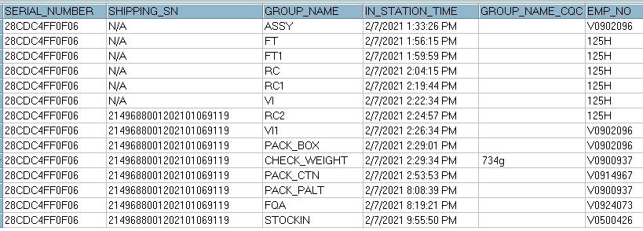
D3. Containment
Check production data
Production data : Doing follow normal process , no abnormal issue.
Result : This DUT not be rework or repair data.

Slide 5
D3. Containment
Check production data
Follow SFIS data, this DUT on full Carton ( 10 Units ) and Full Pallet. No separate Caron or pallet record
TT | SERIAL_NUMBER | SHIPPING_SN | MCARTON_NO | PALLET_NO | MO_NUMBER | MODEL_NAME | VERSION_CODE | LINE_NAME | GROUP_NAME_CQC | Check Weight | Pack CTN
1 | 28CDC4FF0E60 | 2149688001202101069111 | 214CYA51050912 | PYA81050778 | 2151018536 | T99X171.00 | 08L1 | A8 | 732.6g | 2/7/2021 2:42:38 PM | 2/7/2021 2:53:56 PM
2 | 28CDC4FF0F2E | 2149688001202101069112 | 214CYA51050912 | PYA81050778 | 2151018536 | T99X171.00 | 08L1 | A8 | 732.8g | 2/7/2021 2:28:25 PM | 2/7/2021 2:53:56 PM
3 | 28CDC4FF15CC | 2149688001202101069113 | 214CYA51050912 | PYA81050778 | 2151018536 | T99X171.00 | 08L1 | A8 | 731.2g | 2/7/2021 2:43:16 PM | 2/7/2021 2:53:56 PM
4 | 28CDC4FF0E71 | 2149688001202101069114 | 214CYA51050912 | PYA81050778 | 2151018536 | T99X171.00 | 08L1 | A8 | 736.8g | 2/7/2021 2:29:19 PM | 2/7/2021 2:53:56 PM
5 | 28CDC4FF1559 | 2149688001202101069115 | 214CYA51050912 | PYA81050778 | 2151018536 | T99X171.00 | 08L1 | A8 | 733.8g | 2/7/2021 2:44:45 PM | 2/7/2021 2:53:56 PM
6 | 28CDC4FF0E25 | 2149688001202101069116 | 214CYA51050912 | PYA81050778 | 2151018536 | T99X171.00 | 08L1 | A8 | 733.6g | 2/7/2021 2:29:26 PM | 2/7/2021 2:53:56 PM
7 | 28CDC4FF0F0D | 2149688001202101069117 | 214CYA51050912 | PYA81050778 | 2151018536 | T99X171.00 | 08L1 | A8 | 730.2g | 2/7/2021 2:29:15 PM | 2/7/2021 2:53:56 PM
8 | 28CDC4FF0E01 | 2149688001202101069118 | 214CYA51050912 | PYA81050778 | 2151018536 | T99X171.00 | 08L1 | A8 | 735.4g | 2/7/2021 2:44:11 PM | 2/7/2021 2:53:56 PM
9 | 28CDC4FF0F06 | 2149688001202101069119 | 214CYA51050912 | PYA81050778 | 2151018536 | T99X171.00 | 08L1 | A8 | 734g | 2/7/2021 2:29:34 PM | 2/7/2021 2:53:56 PM
10 | 28CDC4FF0EDD | 2149688001202101069120 | 214CYA51050912 | PYA81050778 | 2151018536 | T99X171.00 | 08L1 | A8 | 732g | 2/7/2021 2:42:33 PM | 2/7/2021 2:53:56 PM
Result : SFIS data is normal for that CTN from Check Weight to Pack_CTN

Slide 6
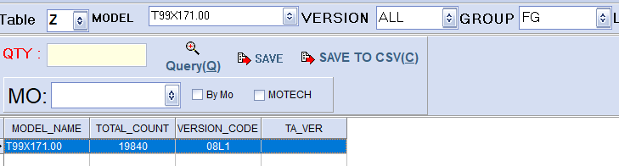
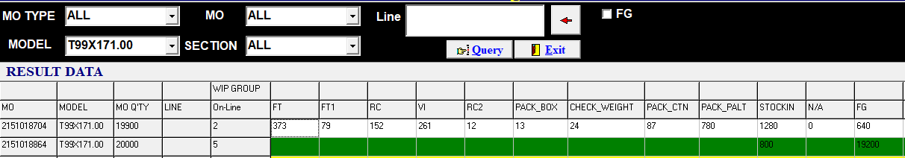
D3. Containment
Check all factory inventory.
Result : Check 19,840 units in Finish good, 3,881pcs in WIP Not found SN “2149688001202101069119” in any record.

Slide 7
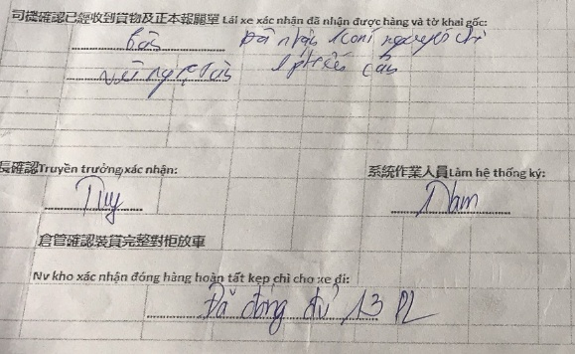
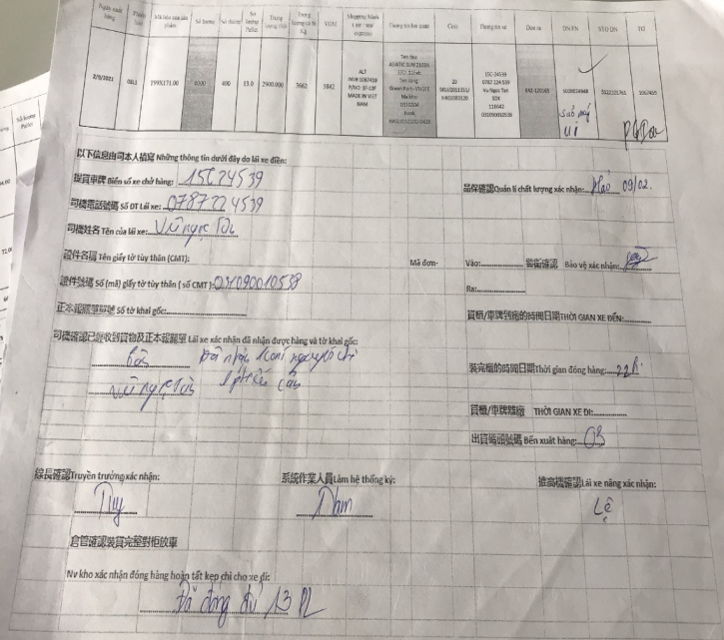

D3. Containment
Check Shipping data, Shipping inspection by WH / CQA and Security result.
SN | DN No | Carton_ID | Pallet_ID
2149688001202101069119 | 5028024945 | 214CYA51050912 | PYA81050778
Result : 1. Foxconn shipping total 4000 units on 2021/02/09.
2. Shipping inspection by Security, WH leader, CQA don’t found any abnormal

Slide 8
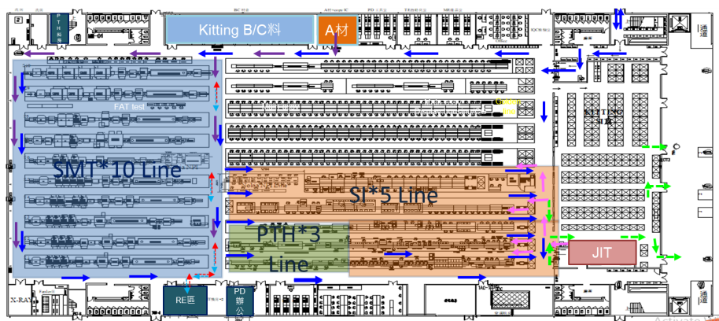
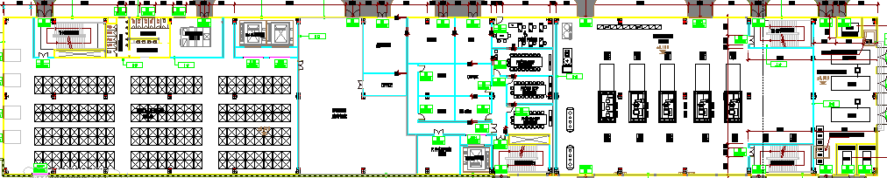
D4. Root Cause
Check Process and Camera layout
B06-1F
Thien Kim Stock ( Shipping area)
1
3
2
Shipping area
4
Product after packing will transfer to Thien Kim Stock for shipping by Car
1
Production line
2
Kitting area
3
Put in transfer car
That device produced from 07/Feb then transfer to Thien Kim stock before arrange shipment on 09/Feb
4
Put in Container for shipping out

Slide 9
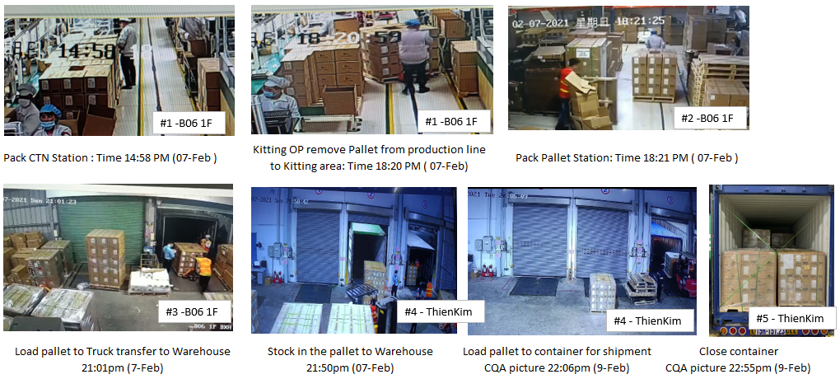
D4. Root Cause (Process verify)
Pallet #:
PYA81050778
Pallet #:
PYA81050778
Pallet #:
PYA81050778
Pallet #:
PYA81050778
Pallet #:
PYA81050778
Pallet #:
PYA81050778
Pallet #:
PYA81050778
Check all Camera record from that device check-Weight to Shipment, Not found any abnormal – Carton and Pallet did not open during process

Slide 10
D4. Root Cause (Process verify)
Continue to take investigate with Logistic and Customer site

Slide 11
D5. Corrective Action

